Slide 1


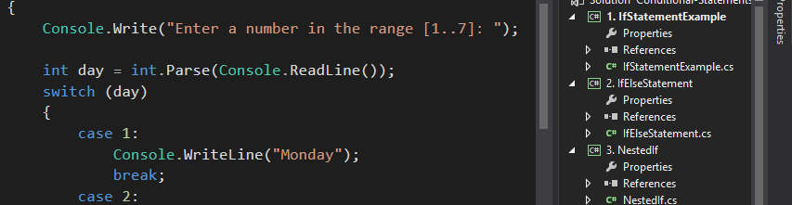
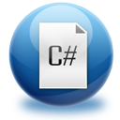
C# Basics
Course Introduction
Svetlin Nakov
Technical Trainer
www.nakov.com
Software University
http://softuni.bg

Slide 2

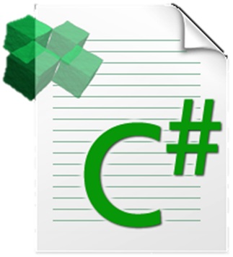
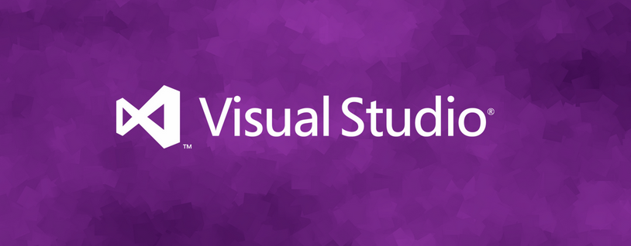
Table of Contents
Course Objectives
Course Program
Trainers Team
Examination
Learning Resources

Slide 3







SoftUni Diamond Partners

Slide 4

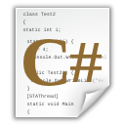
C# Basics Course
C# Basics
Course Objectives & Program

Slide 5
Course Objectives
The "C# Basics" course:
First steps in computer programming:
Compiler, IDE, variables, control-flow logic, console I/O, loops
Establish algorithmic thinking
Development of problems solving skills
Prepare for learning other languages and software technologies
Java, HTML, CSS, JavaScript, PHP
Databases & SQL, high-quality code
Web development technologies

Slide 6
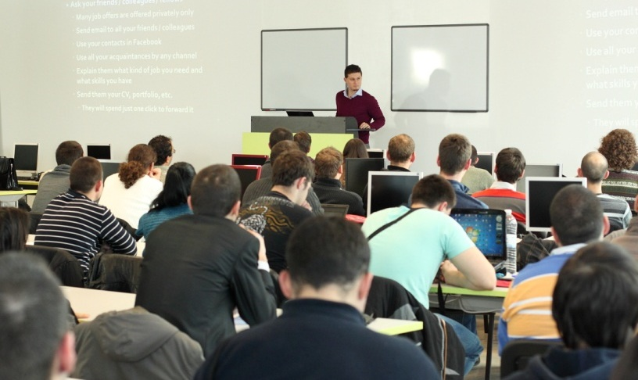
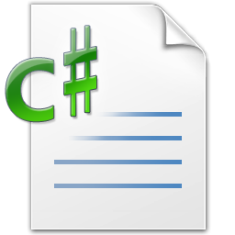
C# Basics – Course Topics
Course Intro. Introduction to Programming. Using the IDE
Primitive Data Types, Variables, Literals
Operators, Expressions and Statements
Console-Based Input and Output
Conditional Statements (if-else, switch-case)
Loops (while, do-while, for, foreach)
Advanced Topics: Methods, Arrays, Lists, Strings
Exam Preparation: Solving Sample Exams
Practical Exam

Slide 7
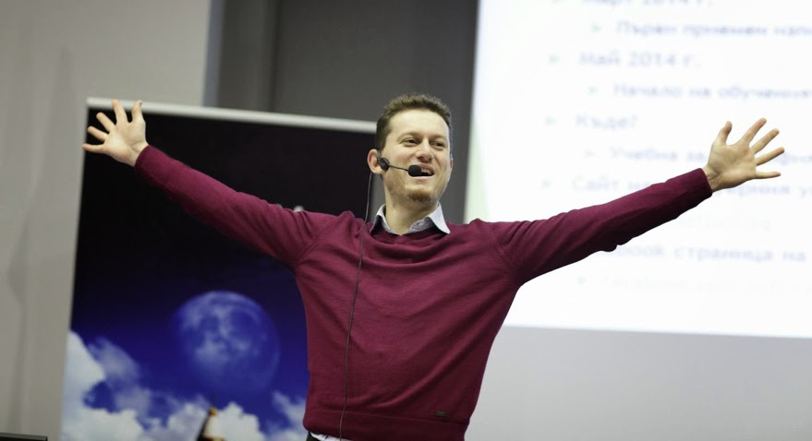
The Trainers Team

Slide 8
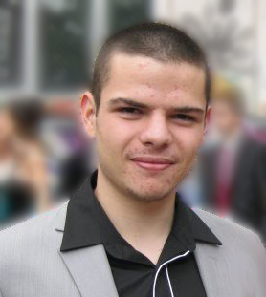
Trainers Team
Bogomil Dimitrov
Top performing student from SoftUni
Currently Level #2

Slide 9
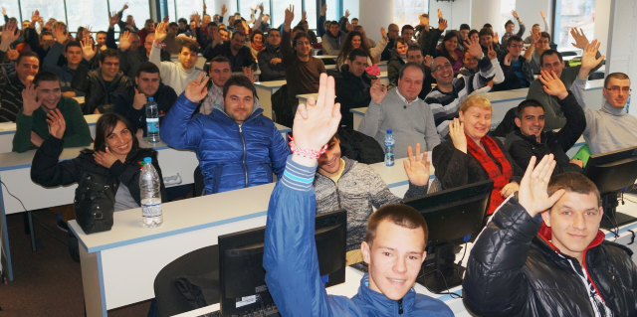

Volunteer Teaching Assistants
20+ volunteer teaching assistants
Students from SoftUni (Level #1)
Top performers from previous C# Basics courses

Slide 10
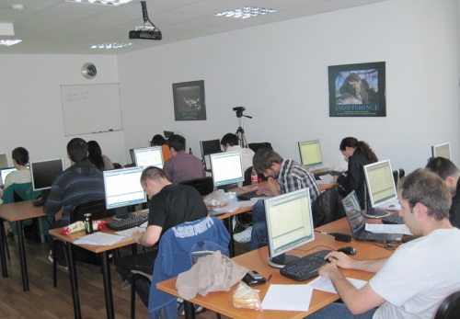

C# Basics Course: More Details
Duration, Languages, Technologies

Slide 11


Training Duration – C# Basics
Lectures: ~ 16 hours (onsite + YouTube videos)
Practical exercises (in class): ~ 16 hours
Homework: ~ 50-100 hours
Exam: 6 hours
Allocation
Timeframe: October– December 2014
Exam: mid-December 2014

Slide 12
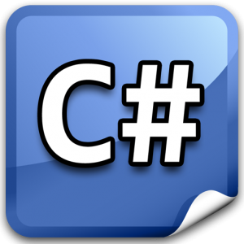


Why C# and .NET Framework?
C#. .NET and Visual Studio in Windows environment
Excellent start for beginners, very easy to learn
The C# language
Modern object-oriented language
Very popular, used by millions developers
Easy to learn, yet very powerful
C# is just the start!
We will learn Java, PHP, Linux, HTML, JS, SQL, and many more

Slide 13


Why English?
Why the slides are in English?
English is the native language of the software engineers
Specific terminology should be in English
Translations are inaccurate and funny
Just learn English!
No excuses

Slide 14

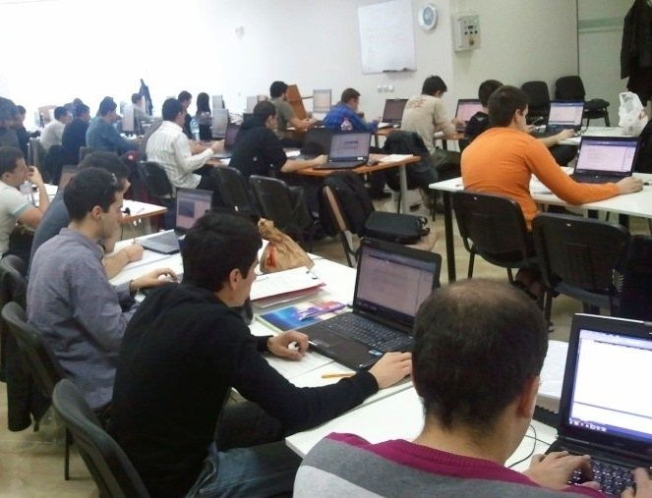
C# Basics
Evaluation Criteria

Slide 15

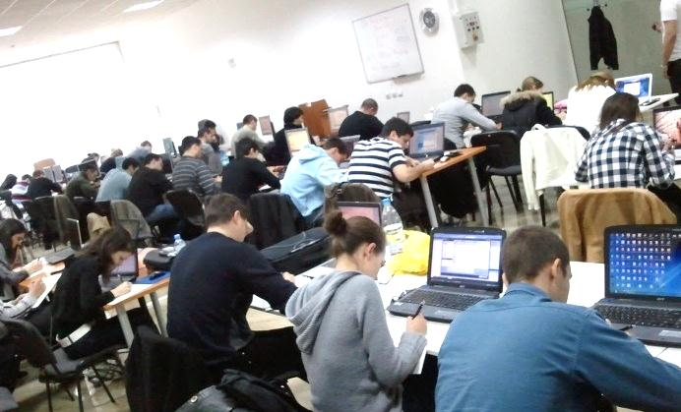
Exams @ Software University
Exams measure the individual performance
Score formed by several components:
Exam results, homework, forums activity, etc.
The "C# Basics" exam serves as admission criteria for the Software University

Slide 16
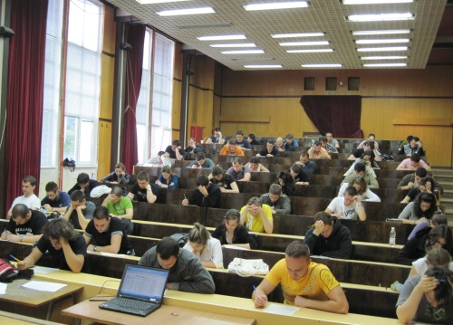

C# Basics Exam
Practical Programming Exam
5 practical problems for 6 hours
1 very easy, 3 with loops, 1 with bit operations
Covers all learned topics up to the moment
Without the "Advanced" topics
Automated judge system & real-time feedback
Solutions are evaluated for correctness only
Code quality is not measured

Slide 17
C# Exam – Sample Problem
Write a program that enters a positive integer number N from the console (1 ≤ N ≤ 100) and prints a new year tree of size N, following the examples below:
N = 1
|
* | *
N = 2
|
* | *
** | **
N = 3
|
* | *
** | **
*** | ***
N = 4
|
* | *
** | **
*** | ***
**** | ****
N = 5
|
* | *
** | **
*** | ***
**** | ****
***** | *****

Slide 18
C# Exam – Sample Solution
static void Main()
{
int n = int.Parse(Console.ReadLine());
for (int i = 0; i <= n; i++)
{
int asterisksCount = i;
string asterisks = new string('*', asterisksCount);
int spacesCount = n - asterisksCount;
string spaces = new string(' ', spacesCount);
Console.Write(spaces);
Console.Write(asterisks);
Console.Write(" | ");
Console.Write(asterisks);
Console.WriteLine(spaces);
}
}

Slide 19


Scoring System for the "C# Basics" Course
Onsite students
Exam – 80%
Serves as pass / fail criteria
Homework + evaluation – 10% + 10%
Forums activity – bonus up to 10%
Online students
Exam – 100%
Forums activity – bonus up to 10%

Slide 20

Homework Peer Reviews
Everyone will give feedback to a few random homework submissions
Students submit homework anonymously
Please exclude your name from the submissions!
For each homework submitted
Students evaluate 3 random homeworks
From the same topic, after the deadline
Give written feedback, at least 200 characters
Low-quality feedback → report for punishment
Everyone will get feedback for their homework

Slide 21

The Judge System at the Exam
All exam problems will be tested automatically
Through our automated online judge system
During the exam preparation you will practice how to use the automated judge system
You can register at any time to practice
How the testing (judge) system works?
You submit your C# source code
Your solution is tested with predefined tests
For each test passed you get some score

Slide 22

Homework Assignments
Doing your homework is very important!
Programming can only be learned through a lot of practice!
You should write code every day!
Each lecture is followed by a few exercises
Try to solve them in class
The rest are your homework
Homework assignments are due in 2 weeks after each lecture
Submission will be accepted through our web site: softuni.bg

Slide 23





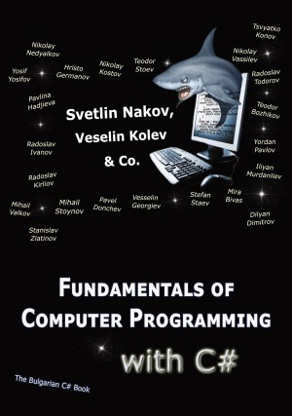



Resources
What We Need Additionally?

Slide 24

Course Web Site & Forums
The C# Basics official web site:
Register for the "Software University Forum":
Discuss the course exercises with your colleagues
Find solutions for all course exercises
Share source code / discuss ideas / help each other
http://softuni.bg/courses/csharp-basics
http://softuni.bg/forum

Slide 25



The C# Programming Slides and Videos
All lecture slides, videos, homework assignments, projects and other resources are open content, available for free
Visit the course web site to access the course resources

Slide 26

The Free C# Fundamentals Textbook
The official textbook for the course
“Fundamentals of Computer Programming with C#”, by Svetlin Nakov & Co., 2013, ISBN 9789544007737
English and Bulgarian versions (as PDF, ePub, …)
Freely downloadable from: www.introprogramming.info
The C# programming courses @ SoftUni.bg follow the book
C# Basics → chapters 1..6 (up to Loops) + few advanced topics

Slide 27
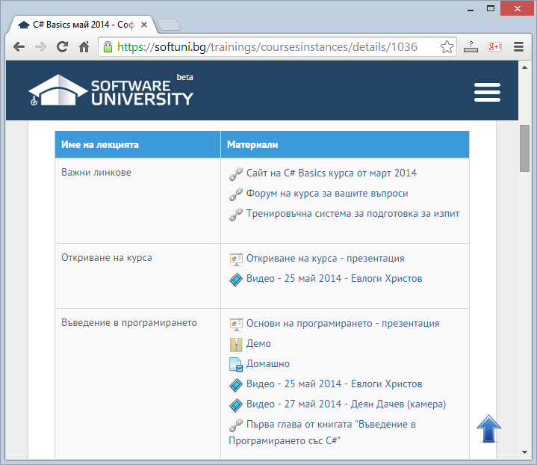
Software University Learning System (SULS)
Software University Learning System (SULS)
www.softuni.bg
Important resource for all students
Homework submissions
Homework check-up
Exams and results
Reports about your progress
…

Slide 28


Required Software
Software needed for this course:
Microsoft Windows (Win 8.1 / Win8 / Win7 / Win XP)
Microsoft Visual Studio 2013 or Visual Studio Express 2013 for Windows Desktop (a free version of VS 2013)
.NET Framework 4.5 (included in Visual Studio)
Visual Studio 2012, 2010, 2008, 2005 is also acceptable

Slide 29

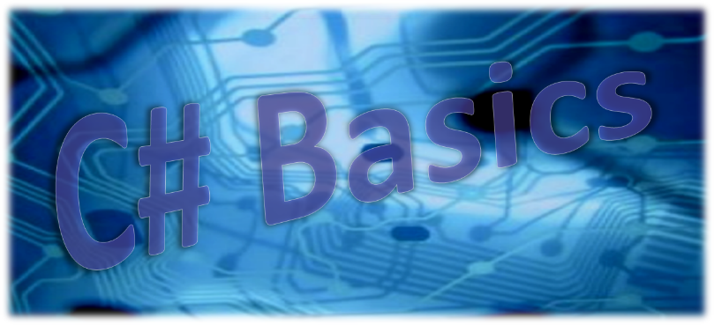
Summary
The "C# Basics" course provides
The very first steps in programming
Training program
Programming, using Visual Studio, variables, control-flow logic, loops, advanced topics
Practical exams
Automated judge system + score system
Learning resources
Lectures, videos, software, books, forum

Slide 30
C# Basics – Course Introduction
http://softuni.bg/courses/csharp-basics

Slide 31
License
This course (slides, examples, demos, videos, homework, etc.) is licensed under the "Creative Commons Attribution-NonCommercial-ShareAlike 4.0 International" license
Attribution: this work may contain portions from
"Fundamentals of Computer Programming with C#" book by Svetlin Nakov & Co. under CC-BY-SA license
"C# Part I" course by Telerik Academy under CC-BY-NC-SA license

Slide 32





Free Trainings @ Software University
Software University Foundation – softuni.org
Software University – High-Quality Education, Profession and Job for Software Developers
softuni.bg
Software University @ Facebook
facebook.com/SoftwareUniversity
Software University @ YouTube
youtube.com/SoftwareUniversity
Software University Forums – forum.softuni.bg

